Slide 1
Data Link Layer Design Issues
Services Provided to the Network Layer
Framing
Error Control
Flow Control

Slide 2
Flow control
Flow control is a set of procedures that tells the sender how much data it can transmit before it must wait for an acknowledgment from the receiver.
The flow of data must not be allowed to overwhelm the receiver.
Any receiving device has a limited speed at which it can process incoming data and a limited amount of memory in which to store incoming data.

Slide 3
CATEGORIES OF FLOW CONTROL
Stop-and-Wait Protocol
Sliding Window Protocol

Slide 4
Stop-and-Wait Protocol
Protocols in which the sender sends one frame and then waits for an acknowledgment before proceeding are called Stop-and-Wait Protocol
source sends a packet and only after receiving the acknowledgment from the destination, it sends next packet.
simple protocol, but it results in lots of delay, and the bandwidth is not used efficiently.
When the source (end system A) sends the first packet to the destination (end system B) and waits for the acknowledgment, then B sends an acknowledgement packet.
Then A sends the second packet, and B sends the acknowledgement. A repeat this process until sender A transmit an end of transmission frame (EOT).

Slide 5
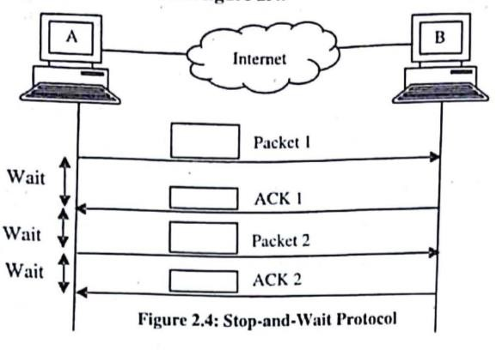
Stop-and-Wait Protocol

Slide 6
Stop-and-Wait Protocol
Advantages
It is a very simple protocol of flow control.
The next frame is sent only when the first frame is acknowledged. So, there is no chance of any frame being lost.
Disadvantages
Only single frame is transmitted which makes the protocol inefficient
Throughput is very poor and the channel bandwidth is not used efficiently.

Slide 7
Sliding Window Protocol
In the elementary data link protocols, data frames are transmitted in one direction only but there is a need to transmitting data in both directions.
This is achieved by sliding window protocol.
In the sliding window method, the sender can transmit several frames before getting an acknowledgment.
Frames can be sent one after another, meaning that the link can carry several frames at once and its capacity can be used efficiently.

Slide 8
Types of Sliding Window Protocol
Go-Back-N Protocol
Selective Repeat Protocol

Slide 9
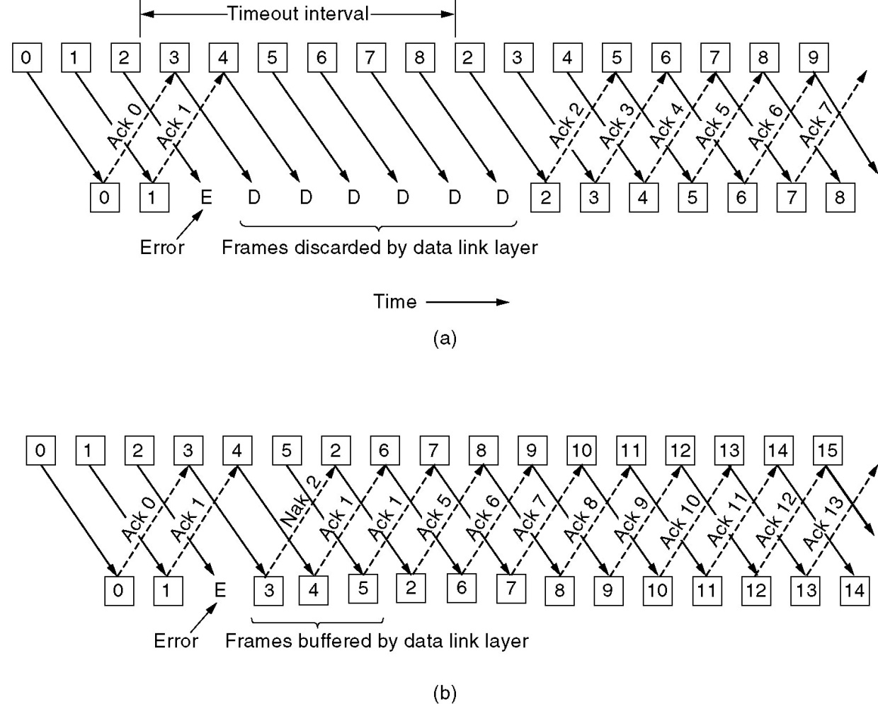
Go-Back-N Protocol
Frames 0 and 1 are correctly received and acknowledged.
Frame 2, however, is damaged or lost.
The sender, unaware of this problem, continues to send frames until the timer for frame 2 expires.
Then it backs up to frame 2 and starts all over with it, sending 2, 3, 4, etc. all over again

Slide 10
Selective Repeat
When it is used, a bad frame that is received is discarded, but good frames received after it are buffered.
When the sender times out, only the oldest unacknowledged frame is retransmitted

Slide 11
Selective Repeat
Frames 0 and 1 are again correctly received and acknowledged and frame 2 is lost.
When frame 3 arrives at the receiver, the DLL notices that is has missed a frame
So it sends back a NAK for 2 but buffers 3.
When frames 4 and 5 arrive, they, too, are buffered by the DLL instead of being passed to the network layer.
Eventually, the NAK 2 gets back to the sender, which immediately resends frame 2. When that arrives, the DLL now has 2, 3, 4, and 5 and can pass all of them to the network layer in the correct order.
It can also acknowledge all frames up to and including 5

Slide 12
Sliding Window Protocol
In the sliding window method protocol, several frames can be in transmit at a time.
The sliding window refers to imaginary boxes at both the sender and receiver.
This window can hold frames at either end and provides the upper limit on the number of frames that can be transmitted before requiring an acknowledgment.

Slide 13
Sliding Window Protocol
The sender maintains information about
Size of sender window
Last frame sent
Last acknowledgement received
The receiver acknowledges only some of the frames, using a single ACK to confirm the receipt of multiple data frames.
Receiver holds information about
Size of Receiver window
Last frame received

Slide 14
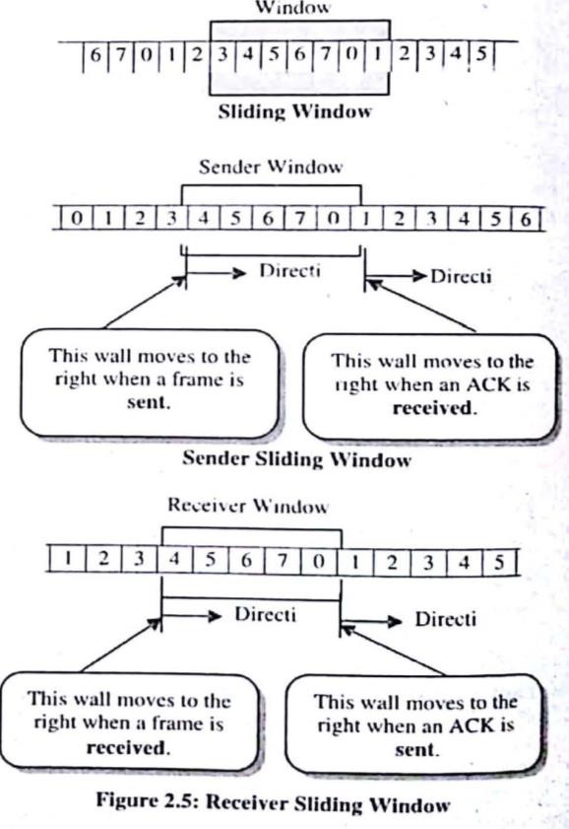

Slide 15
Sliding Window Protocol
Advantages
Network Utilization
Data can be transmitted in both directions.
Several frames can be in transit at a time.
Disadvantages
complexity and hardware capacity
The window can hold n-1 frames at either end. therefore, a minimum of n-1 frame may be cut before an acknowledgment is required

Slide 16
AUTOMATIC REPEAT REQUEST (ARQ)
an error-control method for data transmission that uses acknowledgements (messages sent by the receiver indicating that it has correctly received a data frame or packet) and timeouts (specified periods of time allowed to elapse before an acknowledgment is to be received) to achieve reliable data transmission over an unreliable service
If the sender does not receive an acknowledgment before the timeout, it usually re-transmits the frame/packet until the sender receives an acknowledgment or exceeds a predefined number of re-transmissions.
The receiver will send back an ARQ message to the transmitter to indicate that the last block should be retransmitted

Slide 17
CATEGORIES OF AUTOMATIC REPEAT REQUEST
Stop-and-Wait ARQ
Sliding Window ARQ

Slide 18
Stop-and-Wait ARQ
Stop-and-wait ARQ is a form of stop-and-wait flow control extended to include retransmission of data in case of lost or damaged frames
After transmitting one frame, the sender waits for an acknowledgment before transmitting the next frame.
If the acknowledgment does not arrive after a certain period of time, the sender times out and retransmits the original frame.

Slide 19
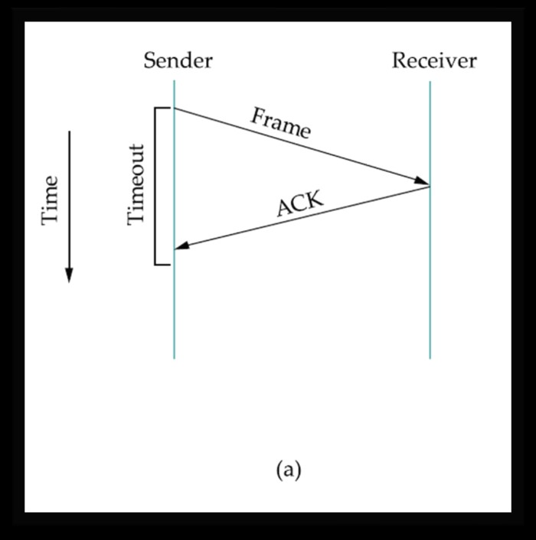
ACK is received before the timer expires

Slide 20
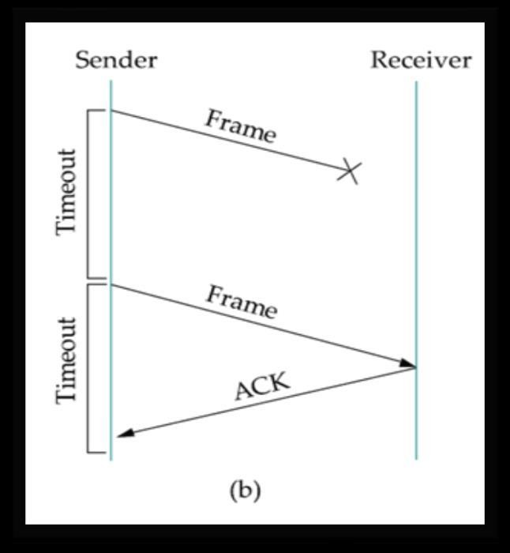
original frame lost

Slide 21
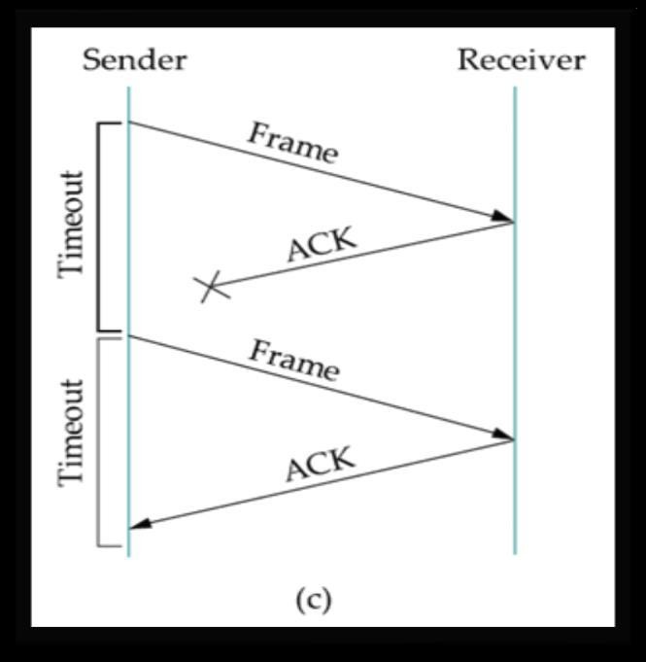
ACK lost

Slide 22
Advantages & Disadvantages
Advantages of Stop-and-Wait ARQ
It has both error and flow control mechanism
It has timer implementation
Easy to implement
Low buffer requirement
Disadvantages of Stop-and-Wait ARQ
Efficiency is very less
Timer should be set for each individual frame
Sender window size is 1
Receiver window size is 1

Slide 23
Sliding Window ARQ
Go-Back-n ARQ
Selective-Repeat ARQ

Slide 24
Go-Back-n ARQ
sending process continues to send a number of frames specified by a window size even without receiving an acknowledgement (ACK) packet from the receiver.
When the receiver finds a frame in error,it tells the sender to resend that frame and all succeeding frames
Cumulative acknowledgment : so for all data only 1 acknowledgment is passed. Traffic is less. But if the any data lost then acknowledgment is not given.

Slide 25
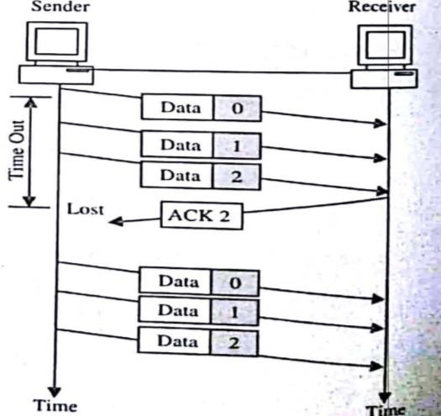
Go-Back-n ARQ(Lost Ack)

Slide 26
Go-Back-n ARQ(Damaged Frame )

Slide 27
Go-Back-n ARQ(Lost Data Frame )

Slide 28
Selective Repeat ARQ
sender sends a number of frames specified by a window size even without the need to wait for individual ACK from the receiver as in stop-and wait.
However, the receiver sends ACK for each frame individually, which is not like cumulative ACK as used with go-back-n.
The receiver accepts out-of-order frames and buffers them.
The sender individually retransmits frames that have timed out.
In selective-repeat ARQ, only the specific damaged or lost frame is retransmitted.
If a frame is corrupted in transit, a NAK is returned and the frame is resent out of sequence.
The receiving device must be able to sort the frames it has and insert the retransmitted frame into its proper place in the sequence.

Slide 29
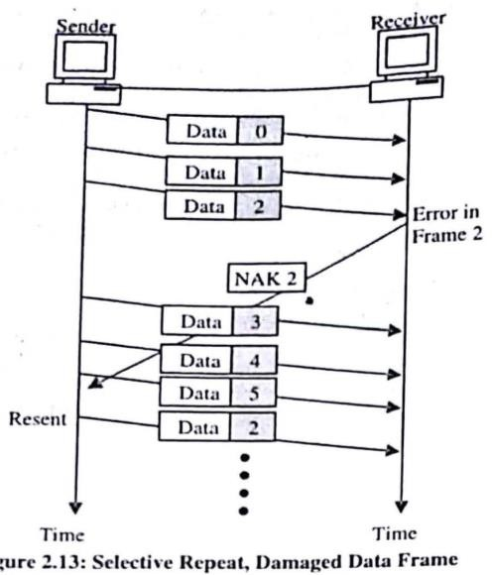
Selective-Repeat ARQ

Slide 30
Advantages &Disadvantages
Advantages
Similar to Go-Back-N ARQ. However, the sender only retransmits frames for which a NAK is received.
Fewer retransmission
Disadvantages of Selective-Repeat ARQ
More complexity at sender and receiver
Each frame must be acknowledged individually
Receiver may receive frames out of sequence

